Slide 1

Python PDF Tools Project (Local Use)
Welcome to the review of our Python PDF Tools Project, designed for local use. In this presentation, we'll cover the current status of the project, our planned improvements, and the exciting next steps for enhancing its capabilities and user experience.
Presented by:
SHAURYA JEET SINGH (RA2411030030009)
RAJAT RAI (RA2411030030030)
KRISHIV BHARDWAJ (RA2411030030011)
KRISHNA CHANDANI (RA2411030030005)
KSHITIZ GUPTA (RA2411030030075)
ARNAV SINGH (RA2411030030024)

Slide 2
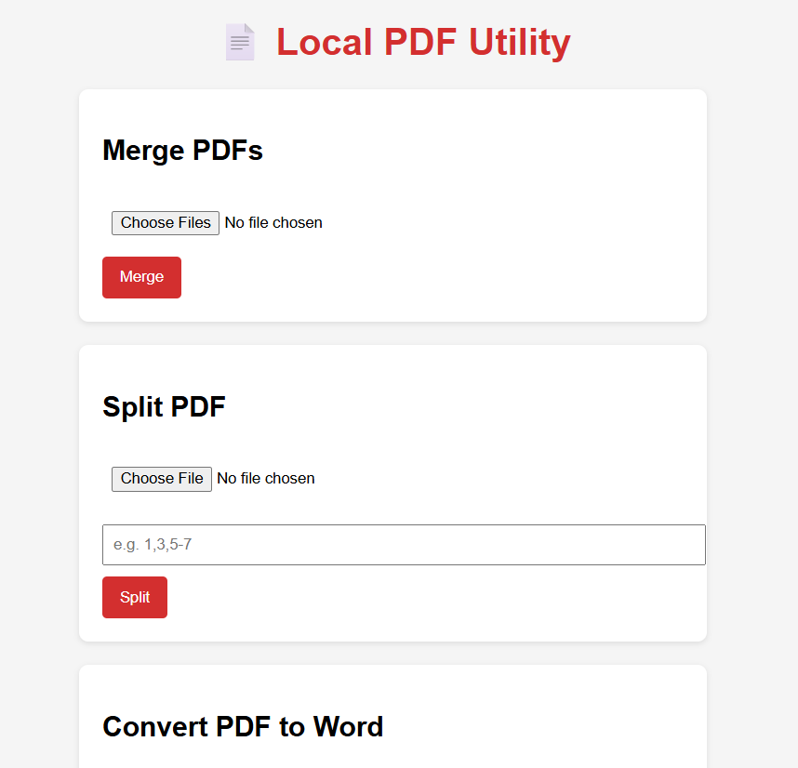
PDF Tools for Local Use
A comprehensive Python-based web application designed for local PDF manipulation and document conversion. This Flask-powered utility provides an intuitive interface for common PDF tasks without requiring cloud services or external dependencies.

Slide 3
Project Overview
Purpose:
Core Features:
Build a robust Flask web application that handles essential PDF operations locally, ensuring privacy and offline functionality for document management tasks.
Merge multiple PDFs into one document
Split PDFs by custom page ranges
Convert PDF files to Word format
Convert Word documents to PDF

Slide 4
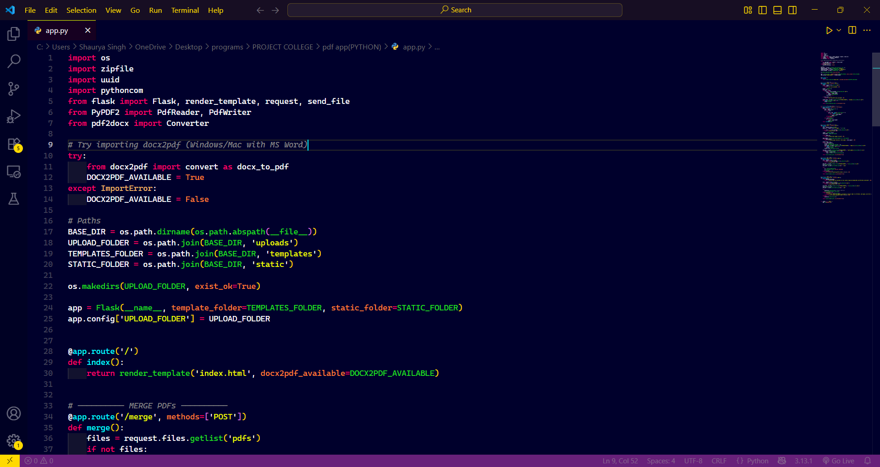



Technical Foundation
Flask Framework:
PyPDF2 Library:
Powers the web server, handles routing, and manages file uploads with secure configuration for templates and static assets.
Enables comprehensive PDF reading and writing operations, including page extraction and document assembly.
Conversion Tools:
Leverages pdf2docx and docx2pdf libraries to seamlessly transform documents between PDF and Word formats.

Slide 5



Application Architecture
Upload Directory
Template Engine
Static Assets
Configured secure folder for temporary file storage during processing operations.
Organized HTML templates for rendering the user interface and handling form submissions.
CSS, JavaScript, and image resources for enhanced user experience and visual design.
The Flask application instance is initialized with modular configuration, enabling easy customization and deployment across different environments.

Slide 6
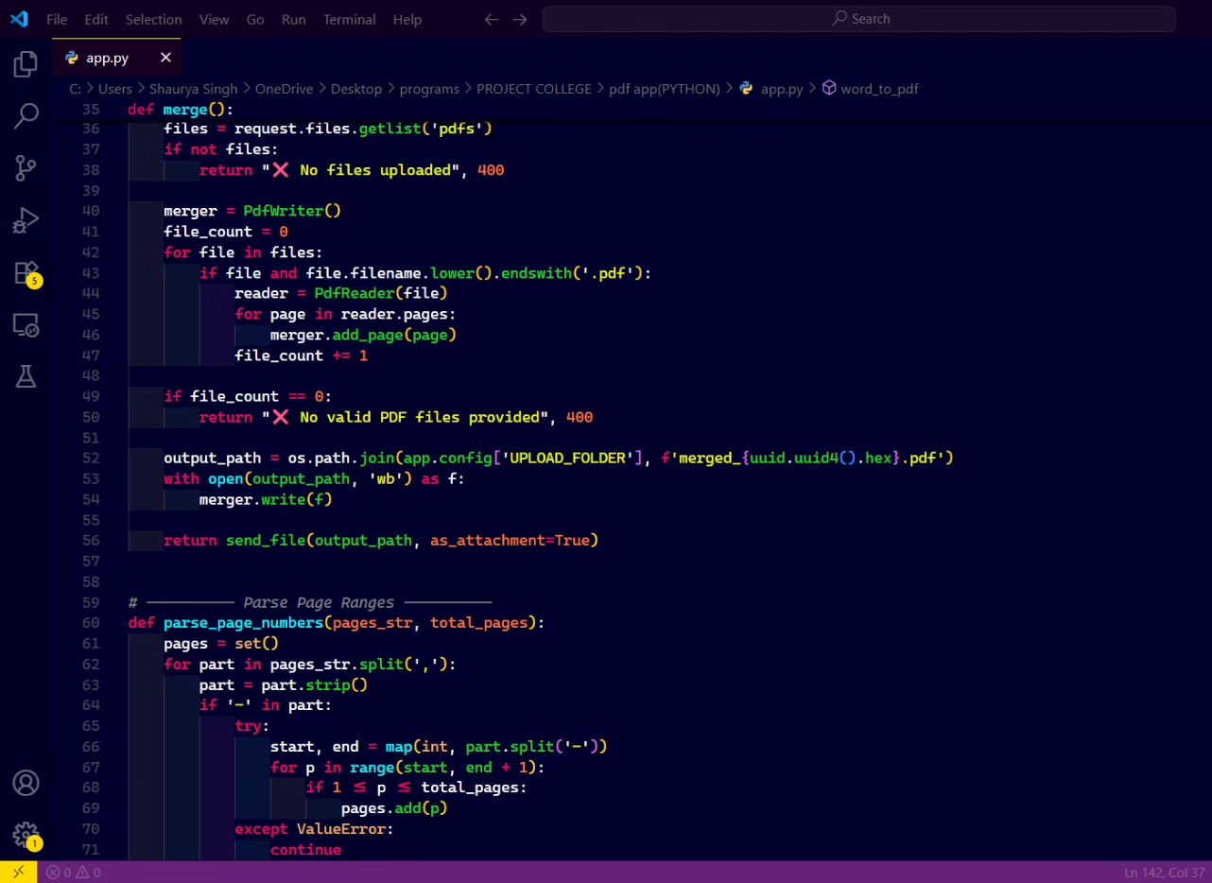
Merge PDF Feature
How It Works:
The merge functionality accepts multiple PDF uploads through a dedicated route. Using PyPDF2's PdfWriter class, the application iterates through each uploaded file, extracting and combining all pages sequentially into a single unified document.
Accepts unlimited PDF file uploads
Preserves original page formatting
Generates downloadable merged output
Maintains document metadata

Slide 7
Split PDF Functionality
01
02
Upload & Input
Parse Ranges
User uploads a PDF and specifies desired page ranges using intuitive syntax (e.g., "1-3, 5, 7-10").
Application intelligently parses the page range input, validating against the total page count.
03
04
Extract Pages
Package Output
PyPDF2 extracts specified pages, creating separate PDF files for each defined range or individual page.
All split files are compressed into a convenient ZIP archive for easy download and organization.

Slide 8
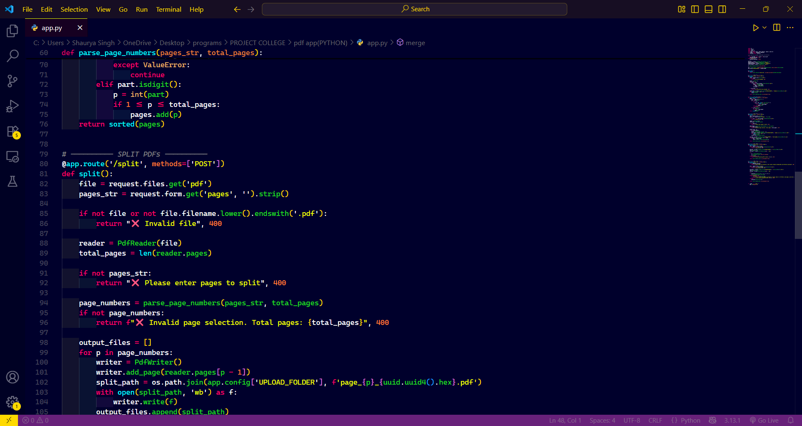
PDF to Word Conversion:
Conversion Process
The PDF-to-Word route leverages the pdf2docx library's Converter class to transform PDF content into editable DOCX format. Users can select specific page ranges for conversion, optimizing output file size.
Key capabilities: Preserves formatting, handles images and tables, maintains text hierarchy, and generates Microsoft Word-compatible documents.

Slide 9
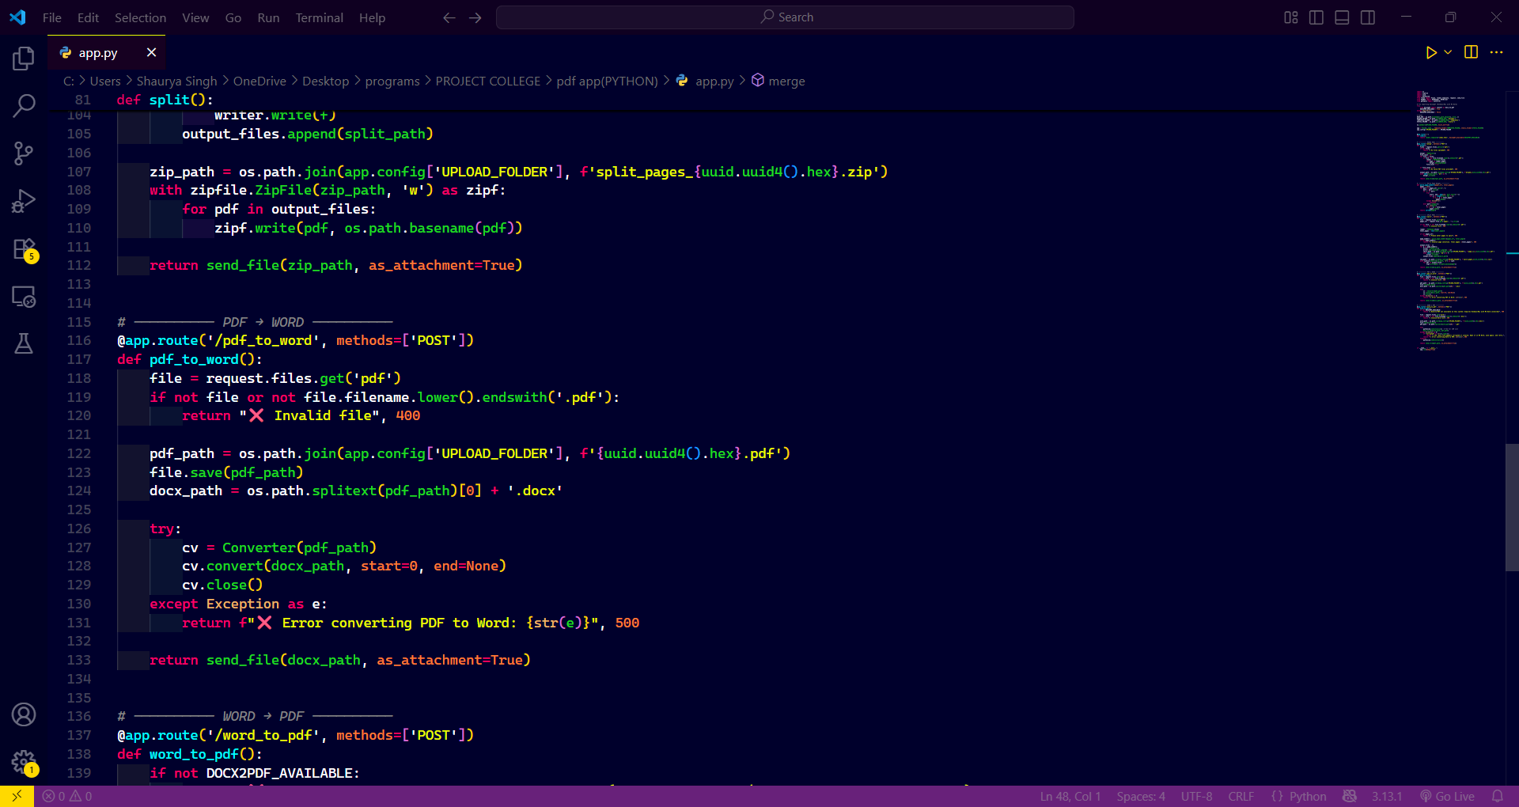
Word to PDF Conversion
Platform Compatibility
Conversion Pipeline
Available exclusively on Windows and macOS systems with Microsoft Word installed, utilizing native COM interfaces for reliable conversion.
Uploaded DOCX files are securely saved, processed through docx2pdf library, and converted to PDF format with comprehensive error handling.
Quality Assurance
Maintains document fidelity including fonts, styles, embedded objects, and complex formatting during the transformation process.

Slide 10
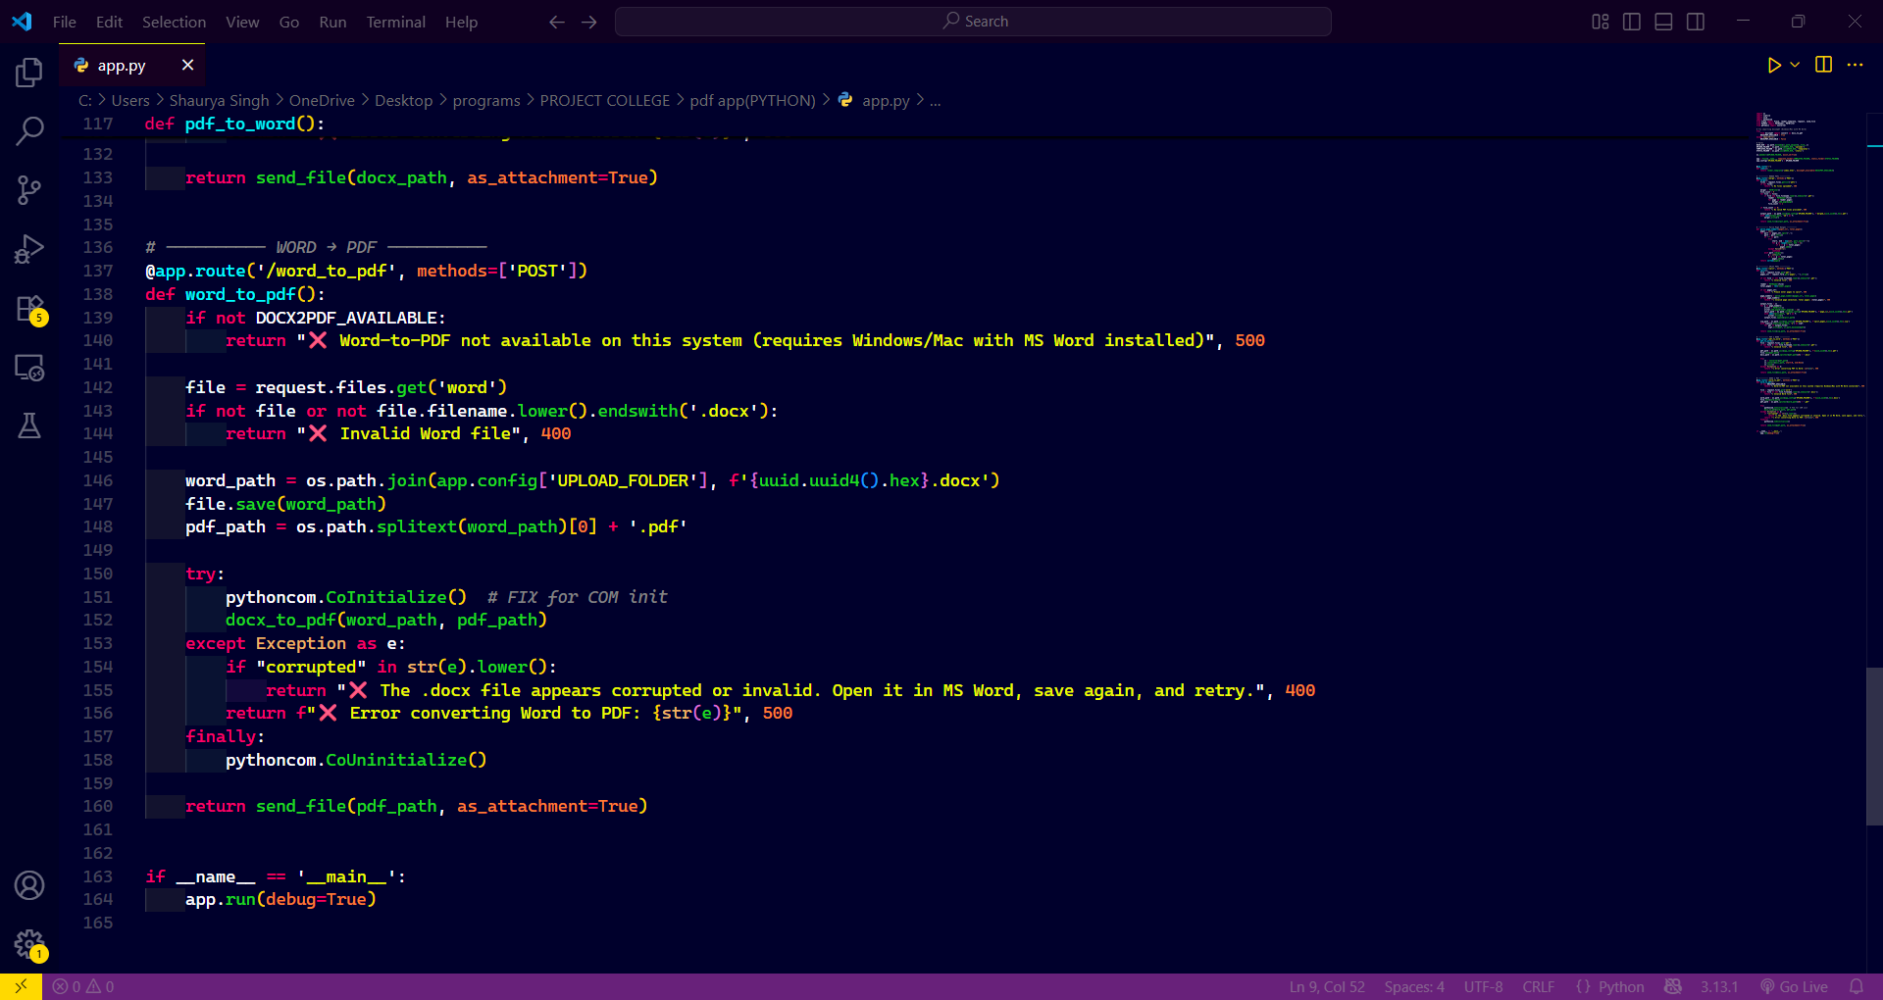
Robust Error Handling
Built-in Safeguards:
The application implements comprehensive validation and error management to ensure reliable operation and user-friendly feedback.
File validation: Checks for valid PDF/DOCX formats before processing
Page range validation: Prevents invalid page selections
UUID filenames: Generates unique identifiers to avoid conflicts
COM initialization: Uses PythonCOM for Windows-specific operations

Slide 11
Project Summary
User-Friendly Interface
Modular Architecture
Extensible Design
Framework readily supports expansion to additional document formats, batch processing, and advanced manipulation features.
Clean, intuitive web UI makes PDF operations accessible to users of all technical levels without command-line complexity.
Each feature implemented as a dedicated Flask route, enabling easy maintenance, testing, and future feature additions.
This local PDF toolkit demonstrates the power of Python web frameworks for creating practical, privacy-focused utilities. The modular design and comprehensive error handling make it an excellent foundation for academic projects and real-world document management needs.

